Slide 1
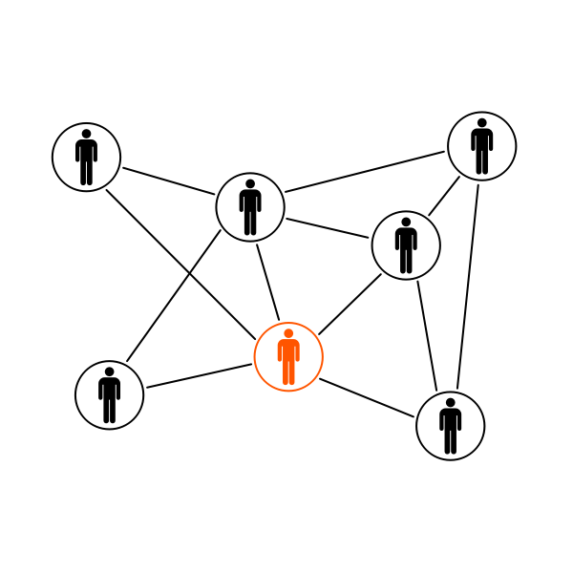
NETWORK

Slide 2
NETWORK
Name: Acceasy Cultural Heritage: European network for cognitive accessibility of cultural heritage”

Slide 3
AIM AND OBJETIVES
TO ADVOCATE FOR THE CULTURAL HERITAGE TO BE ACCESIBLE.
TO ADVOCATE FOR COGNITIVE ACCESSIBILITY AS A RIGHT.
TO DISSEMINATE GOOD PRACTICES ON COGNITIVE ACCESIBLE CULTURAL HERITAGE AND CONTRIBUTE WITH RESOURCES TO MAKE IT POSSIBLE (DATABASE)

Slide 4
WHO CAN JOIN
1. PERSONS WITH COGNITIVE DIFFICULTIES
3. PEOPLE SUPPORTING PEOPLE WITH DISABILITIES
2. TOURISM AND CULTURAL HERITAGE PROFESSIONALS
4.DECISION MAKERS AND ACTIVISTS

Slide 5
HOW TO CONTRIBUTE
Persons with cognitive difficulties
Tell us if there are good examples of cognitively accessible cultural heritage in your country.
Inform us of cultural heritage elements difficult to understand.
Tourism and cultural heritage professionals
Share your work on making your visits or exhibitions accessible for people with cognitive difficulties.
Share accessible educational resources.

Slide 6
HOW TO CONTRIBUTE
People supporting people with disabilities
Tell us if there are good examples of cognitively accessible cultural heritage in your country.
Decision makers and activists
Inform us about initiatives and legislation to promote cognitive accessibility on cultural heritage.
Inform us of cultural heritage elements where you have found barriers for understanding.

Slide 7
WHAT TO EXPECT
Persons with cognitive difficulties
Receive information about cognitive accessible places to visit.
Learn about opportunities of becoming a validator of the accessibility testing process for places or easy to read texts.
Tourism and cultural heritage professionals
Be informed about training opportunities, learn about cognitive accessibility. Get good examples on easy to read tourism info.
Join initiatives to self –advocate for cognitive accessibility in culture.
Discover new ideas and share good practices on accessible tourism and heritage.

Slide 8
WHAT TO EXPECT
People supporting people with disabilities
Receive information and training about cognitive accessibility tools and resources.
Get new ideas about using cultural heritage for social inclusion.
Decision makers
and activists
Be part of the dialogue about culture and accessibility.
Get good examples and educational materials on easy to read about tourism and cultural heritage.
Be informed about training opportunities, learn about cognitive accessibility.
Inform society about your plans, laws and initiatives to make cultural heritage cognitive accessible.

